Slide 1
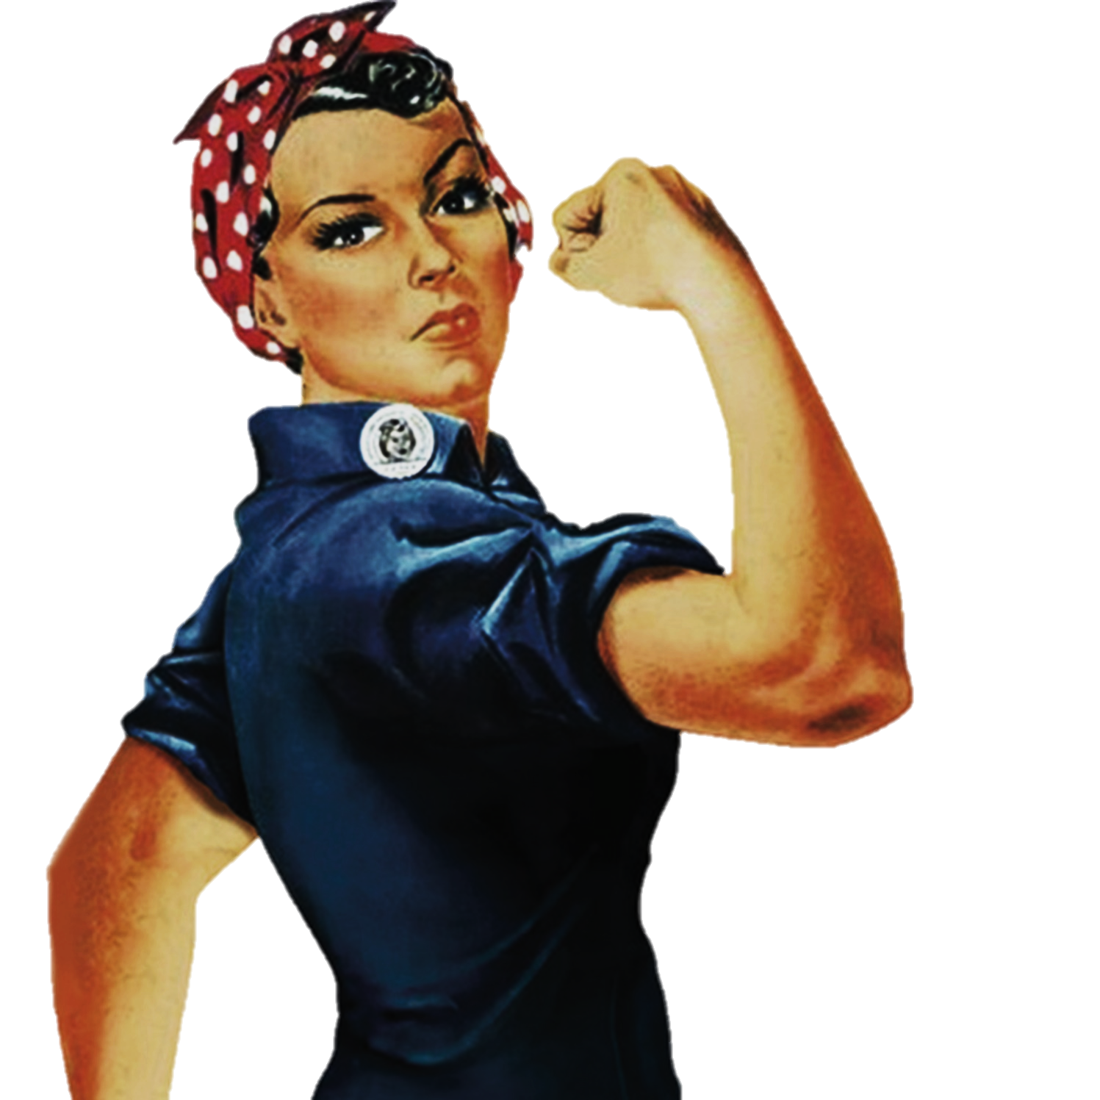
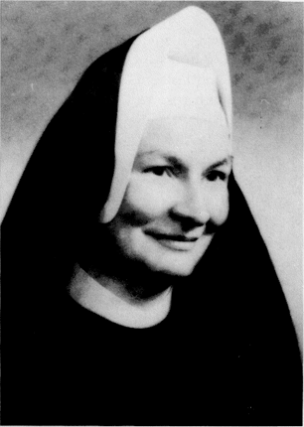
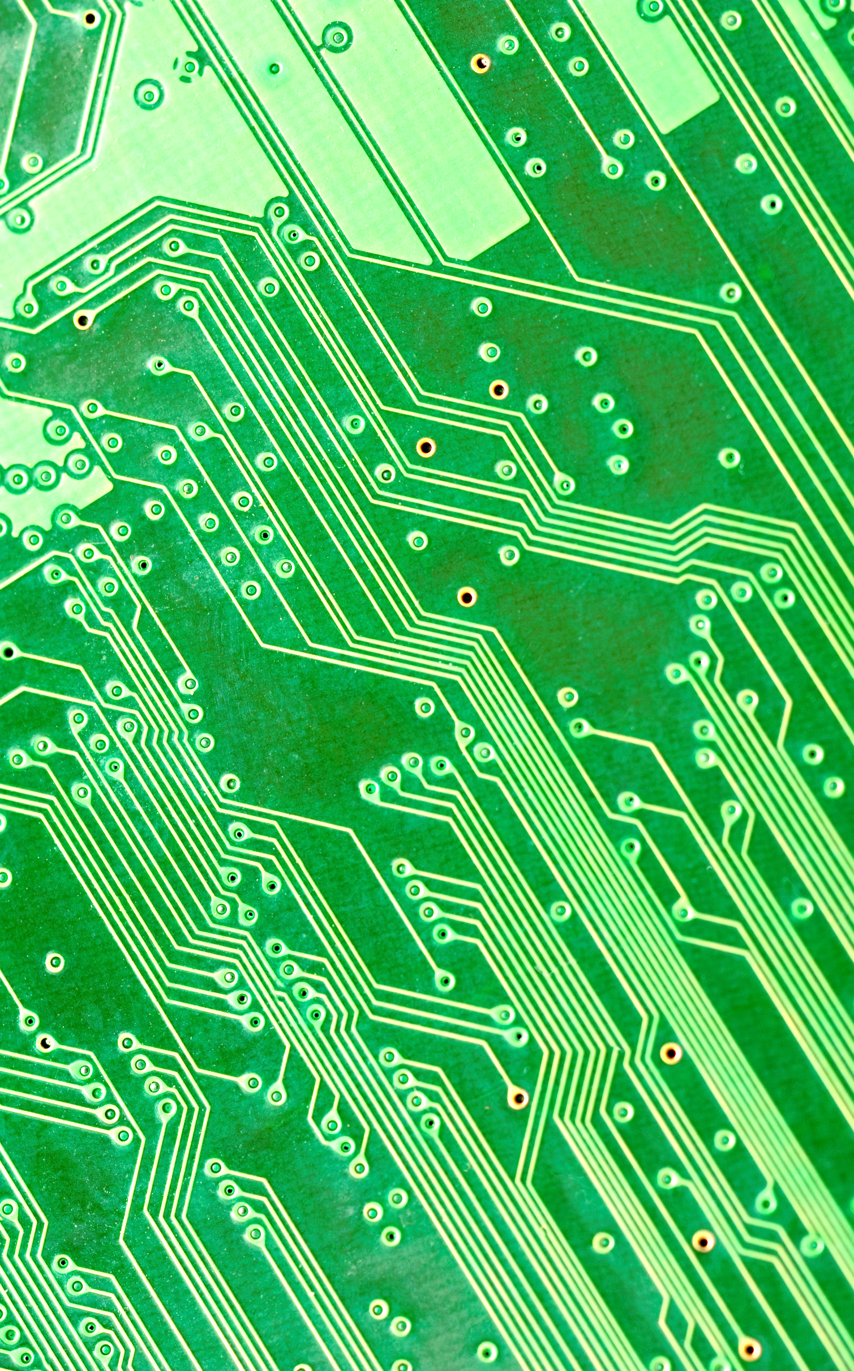
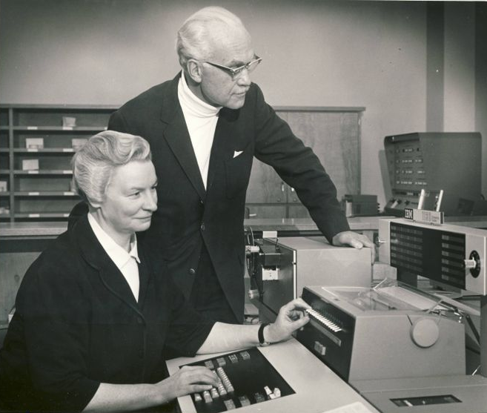
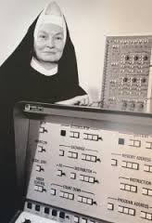
Women
Sister Mary Kenneth Keller
To change pictures:
Save the picture of the person you wish to use.
Single-left-click the grouped picture/shapes you wish to change on the poster. Single-left-click again on the picture.
Now single-right-click the picture and select “Change Picture” from the menu.
Choose the picture file you saved.
You may wish to single-left-click the grouped picture/shapes and single-left-click the new picture again to adjust its size or crop it—especially useful if the new picture is not the same aspect ratio as the previous one.
DO NOT CHANGE ROSIE THE RIVETER PICTURE!!!
In Technology
1965 First woman to earn Computer Science Doctorate
1967 Founded the computer science department at Clarke College in Iowa
“For the first time, we can now mechanically simulate the cognitive process. We can make studies in artificial intelligence. Beyond that, this mechanism [the computer] can be used to assist humans in learning. As we are going to have more mature students in greater numbers as time goes on, this type of teaching will probably be increasingly important.”
She conducted her research at the University of Wisconsin, Purdue, the University of Michigan, and Dartmouth College, where she helped develop the BASIC language. BASIC was one of the biggest breakthroughs in computer science – before it, only people well versed in mathematics could write computer code. BASIC allowed everybody who learned the language to do it, and Keller played an important role in its development.
What paths will you trailblaze that no one has traveled before?

